Slide 1
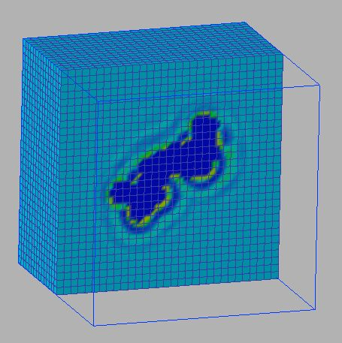
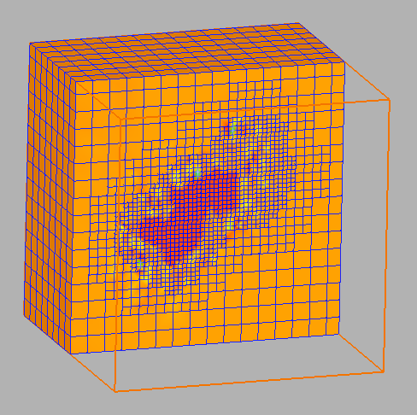
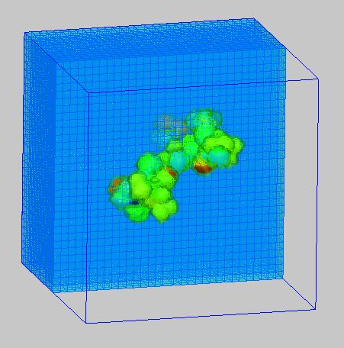
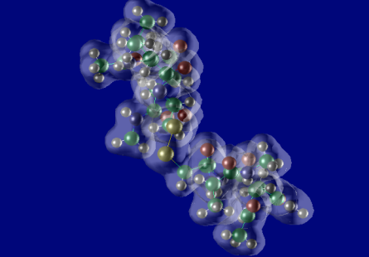
Use case:
RISM-FMO Coupled Simulation
Electronic structure of Nano-scale molecules in solvent is
calculated self-consistent by exchanging solvent charge
distribution and partial charge of solute molecules.
RISM
Solvent distribution
FMO
Electronic structure
Mediator
GridMPI
Mediator
Solvent charge distribution
is transformed from
regular to irregular meshes
Suitable for SMP
Suitable for Cluster
Mulliken charge is transferred for partial charge of solute molecules
*Original RISM and FMO codes are developed by Institute of Molecular Science and
National Institute of Advanced Industrial Science and Technology, respectively.

Slide 2
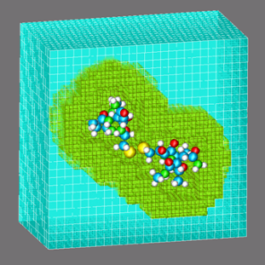
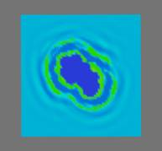
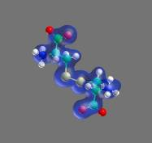
RISM-FMO Application
A coupled simulation of the electronic structure of a molecule in solution
RISM
Reference Interaction Site Model
FMO
Fragment Molecular Orbital method
Electronic Structure
in Solutions
Mediator
Solvent Distribution
Analysis
Electronic Structure
Analysis
GridMPI
Data Transformation
between Different Meshes
GridMPI
Mediator
RISM: CPU=Power4, OS=AIX,
#CPUs=32, #nodes=1
RISM
FMO
FMO: CPU=Xeon, OS=Linux,
#CPUs=128, #nodes=64
Configuration
IMPI
Requirements
Mediator: CPU=Xeon, OS=Linux,
#CPUs=1, #nodes=2
Mediator
IMPI: CPU=Xeon, OS=Linux,
#CPUs=1, #nodes=1
： GridMPI com. ： GridMPI init.

